Slide 1
A Single-Page Application
with Spring Security and Angular JS

Slide 2
Agenda
Really quick introduction to Spring Security, Spring Session, Angular JS
Focus on features to build secure, modern, single-page applications
High level view of sample apps presented in blog series
More detailed look at some of the apps

Slide 3
Spring Security
Generic, Filter based solution for Servlet applications
Authentication (a.k.a. identity) and Authorization (a.k.a. access decisions)
OAuth2 module useful for SSO and token-based API authentication
lots of other features
http://projects.spring.io/spring-security

Slide 4
Angular JS
JavaScript framework
"Magic" binding (dependency injection and MVC)
Has a lot of traction in the enterprise
Nothing about the architecture of the apps presented here requires Angular JS
Really basic usage in samples, but representative

Slide 5
Security Features in Modern Browers
HTTP Basic
X.509 authentication
Kerberos
Cookies
CORS (Common Origin Resource Sharing)
HSTS (HTTP Strict Transport Security)
CSP (Content Security Policy)

Slide 6
Spring Session
Not tied to Spring Security, but works well with it
Easy, declarative, distributed sessions
Redis works out of the box, other backends easy to add
Servlet Filter
http://projects.spring.io/spring-session

Slide 7
Spring Cloud
Toolbox for building distributed systems (a.k.a. microservices)
Most relevant pattern here is Gateway (a.k.a. reverse micro-proxy)
Also useful for configuration management, service discovery, load balancing, circuit breaker, etc.
http://cloud.spring.io

Slide 8
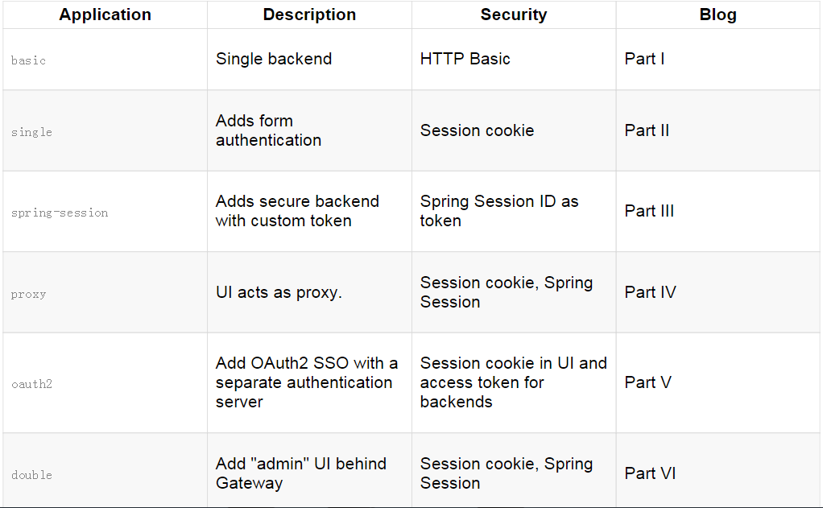
Overview of Sample Apps

Slide 9
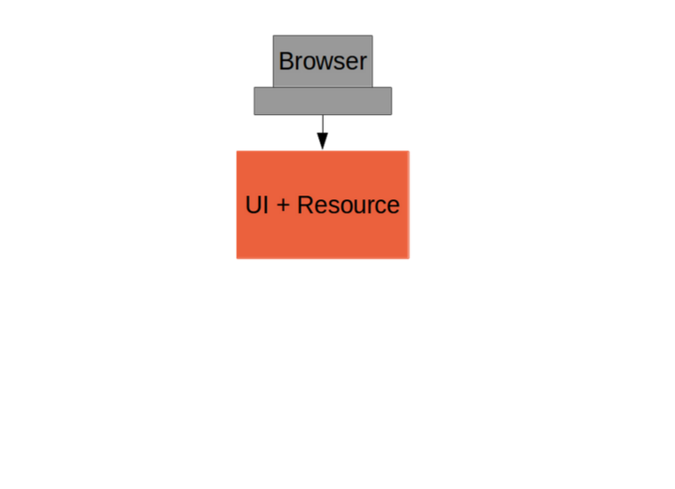
Basic Sample

Slide 10
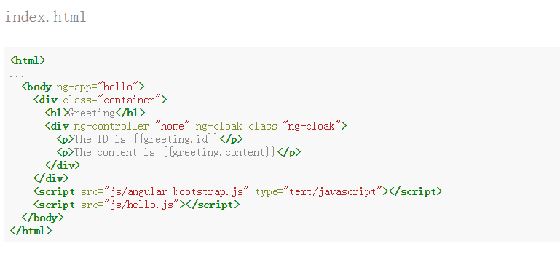
A Single Page Application

Slide 11
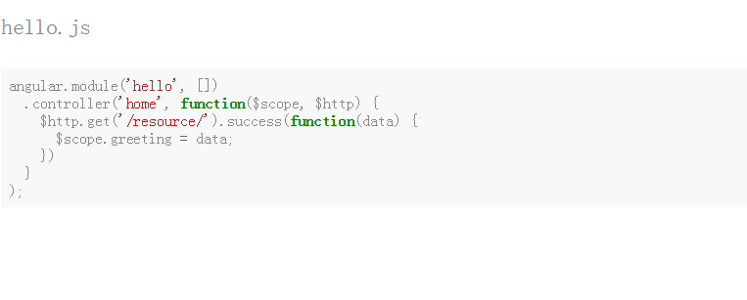
Compleletly Minimal JavaScript

Slide 12
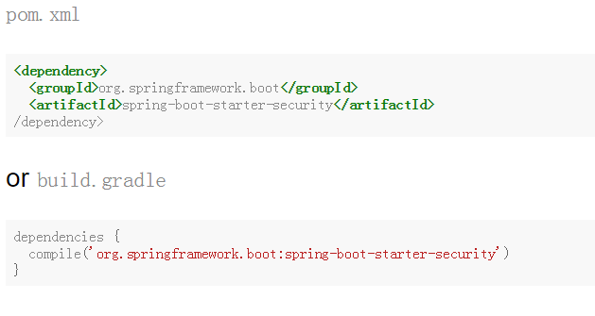
Add HTTP Basic Security
With Spring Boot you get a secure application out of the box, but it is easy to customize for a custom user details store (e.g. directory).

Slide 13
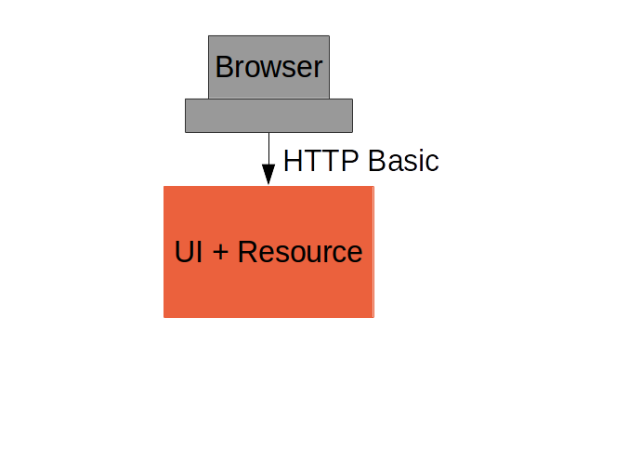
Basic Sample with Authentication

Slide 14
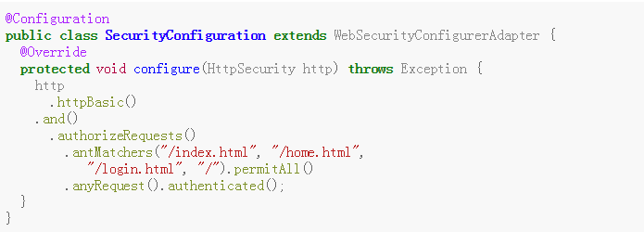
Spring Security: Login Form
To be able to add a login form to the app we need to make some HTML static resources accessible anonymously

Slide 15
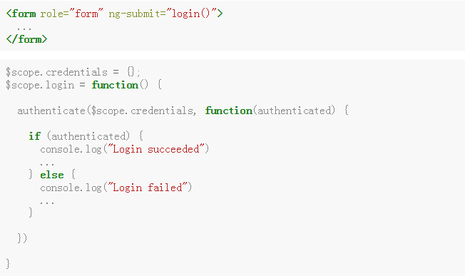
Client Side Login Form
The authenticate() function sends HTTP Basic credentials and checks the "/user" endpoint.
Subsequent requests are authenticated by a cookie - standard Spring Security and browser behaviour
Notes:
The authenticate() function sends HTTP Basic credentials and checks the "/user" endpoint.
Subsequent requests are authenticated by a cookie - standard Spring Security and browser behaviour

Slide 16
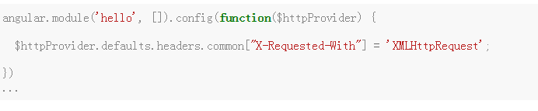
One More Thing
When the browser gets a 401 with "WWW-Authenticate: Basic …​" it pops up a dialog.
Spring Security sends that header unless it sees "X-Requested-With" in the request.

Slide 17
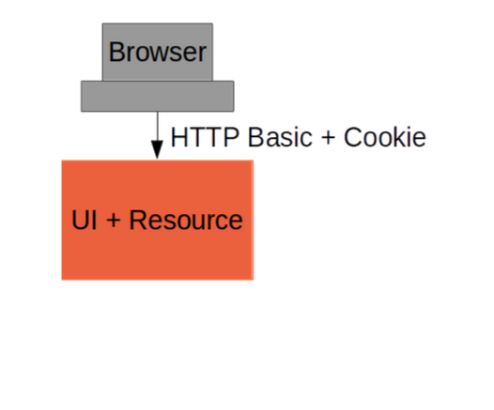
Login Form Summary

Slide 18
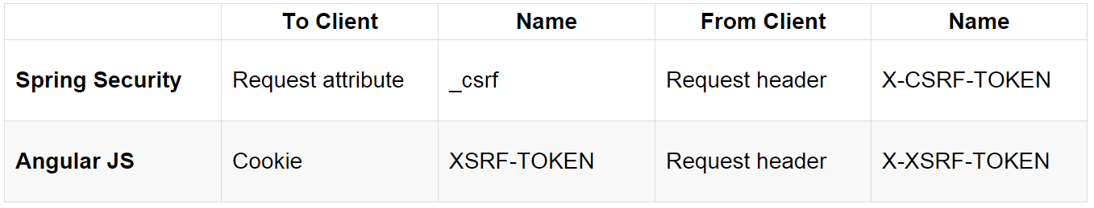
Cross Site Request Forgery (CSRF)
Spring Security and Angular JS have good support for CSRF protection

Slide 19
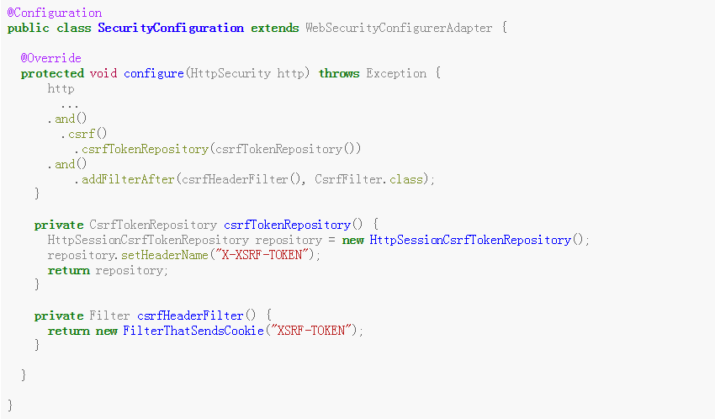
Spring Security for Angular "XSRF"

Slide 20
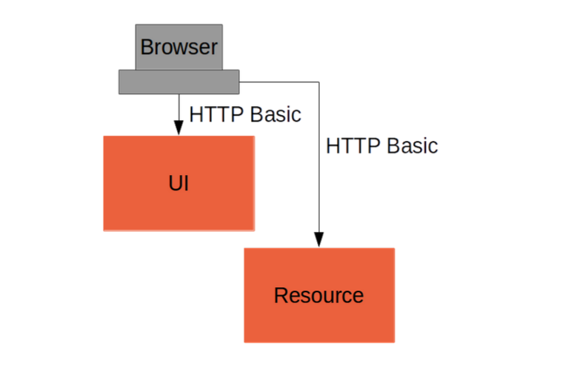
Add Resource Server

Slide 21
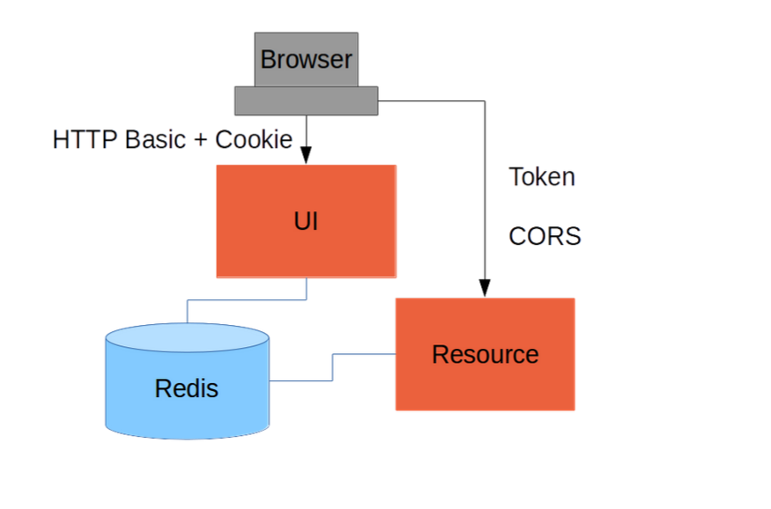
Add Spring Session

Slide 22
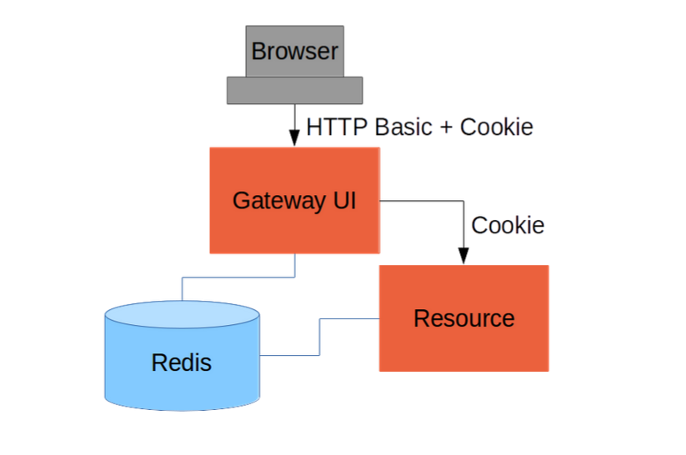
Add Gateway

Slide 23
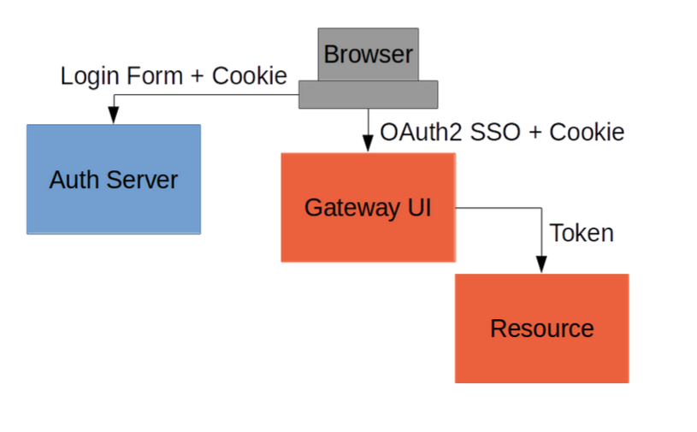
Externalize Authentication (SSO)

Slide 24
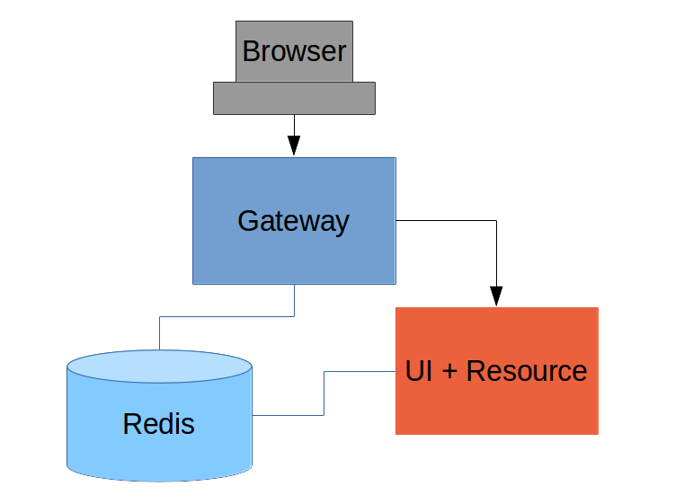
Push UI Below Gateway

Slide 25
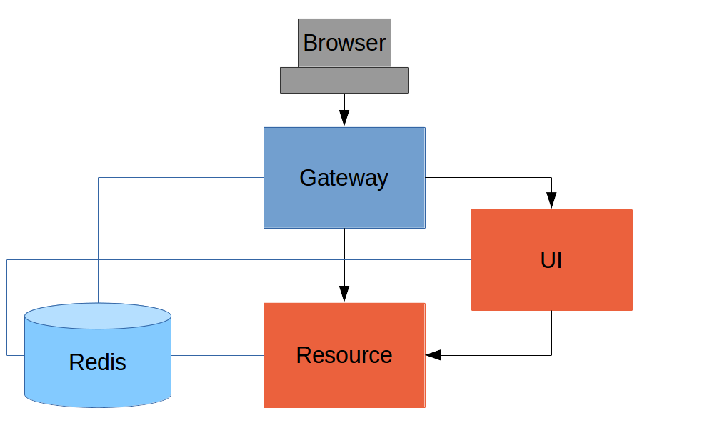
Add Resource Server

Slide 26
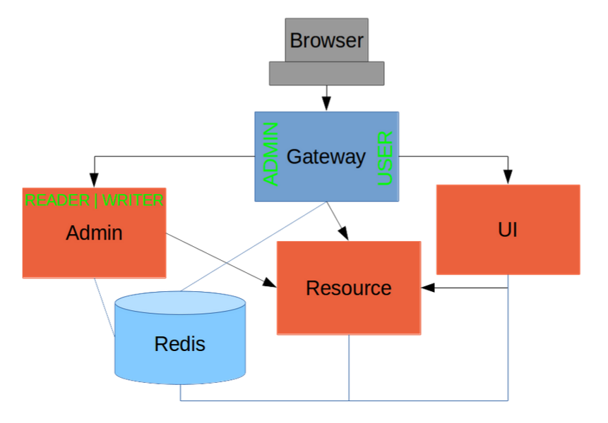
Full "Double" Sample

